Slide 1




STUDENT DEPRESSION
Team members :
Arwa Hamdy Mohammdy
Eslam Mohamed Abd El Fattah
Mariam Mostafa Abdelaziz
Mariam Mostafa Abdelaal

Slide 2

CONTENT
Introduction
Project Objective
Dataset Description
Data Cleaning and Exploratory Data Analysis (EDA)
Visualization and Dashboard
models
Deployment and ML Flow
Suggestions and Solutions

Slide 3
INTRODUCTION
Depression
Student depression is a critical issue affecting academic performance, mental well-being, and social behavior.
Various studies indicate a rise in depression rates among students due to academic pressure, financial stress, social isolation, and personal struggles.
Depression Prediction
In this project, we use data science to analyze factors that may contribute to student depression, such as sleep, study hours, social life, and physical activity.

Slide 4
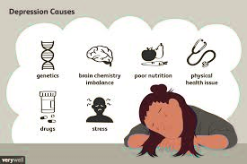
PROJECT OBJECTIVE
Understand the key factors affecting students’ mental health, such as academic stress, lack of sleep, or social isolation.
Build a smart model that can predict whether a student is at risk of depression or not.
Help detect potential depression cases early before things get worse
Raise awareness about mental health by analyzing hidden patterns in students' behavior and lifestyle data.
Handle all personal data with care, respecting students’ privacy and confidentiality.

Slide 5

DATASET DESCRIPTION
01
02
03
Dataset contains 27901 rows & 27 columns Dataset from Kaggle
Source dataset is in csv format.
Dataset contains (17 numeric columns , 10 categorical ).
There is missing values for the provided input dataset.
Depression is the(target) which notifies whether a student is depressed or not.

Slide 6
DATA STRUCTURE & DESCRIPTION
ACADEMIC FACTORS
MENTAL HEALTH
PersonAL INFORMATION
Academic Pressure
CGPA
Degree
Study Satisfaction
Work/Study Hours
Have you ever had suicidal thoughts ?
Depression
PHQ-9
Cortisol_Level
id
gender
age
city
pet ownership
favorite color
EMOTIONAL FACTORS
HEALTH HABITS
Financial Stress
Family History of Mental Illness
Social Isolation
Bullying
Family Issues
Uncertain Future
Social Media Usage
Sleep Duration
Dietary Habits
Drug/Smoking
Daily Coffee Intake
Music Genre Preference

Slide 7
EDA

Slide 8
DATA CLEANING
MISSING VALUES
We found nulls in column “Financial Stress” . Dealing with missing values by removing rows.
DUPLICATES
No duplicates found.
OUTLIERS
We found outliers in column “PHQ-9” . Dealing with outliers by keeping them because of Their Low Percentage.

Slide 9
DATA CLEANING
SCALING
Using Standard Scaling ,but No need for scaling, only when using special models.
COLUMN DELETION
After correlation, deleting less important columns is necessary.
BALANCE
check balance in target column ”Depression”. Unfortunately was unbalanced.
CORRELATION
Using chi2_contingency,Correlation matrix
,Check correlation between target columns with others.

Slide 10
VISUALIZATIONS

Slide 11
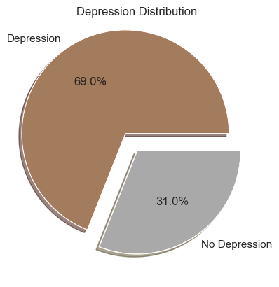
pERCENTAGE OF DEPRESSION
We have an issue where 69% of Students is Depressed.

Slide 12
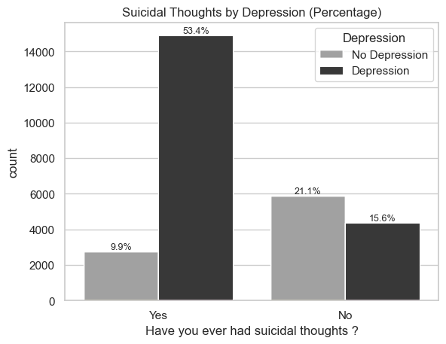
DEPRESSION BY SUICIDAL THOUGHTS
Nearly 54% of students with suicidal thoughts are Depressed.

Slide 13
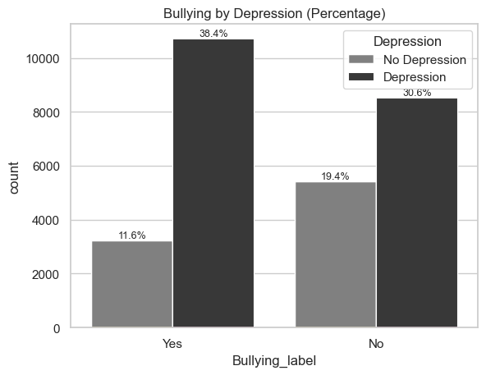
DEPRESSION BY BULLYING
Nearly 39% of bullied students are Depressed.

Slide 14
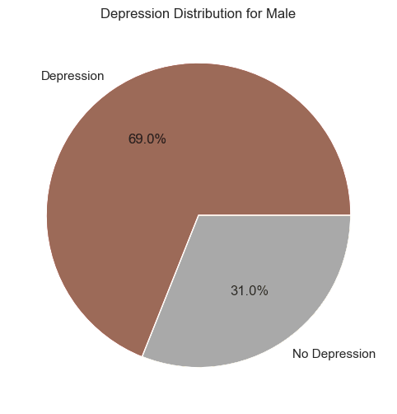
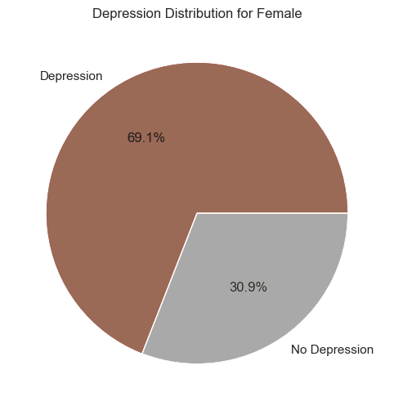
DEpRESSION BY GENDER
69% of Males are Depressed.
69.1% of Females are Depressed.

Slide 15
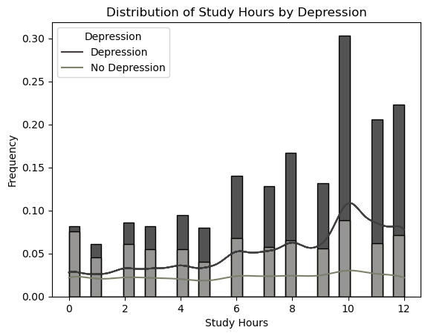
DEPRESSION BY STUDY HOURS
There is a higher likelihood of depression among students who study more than 6 hours.

Slide 16
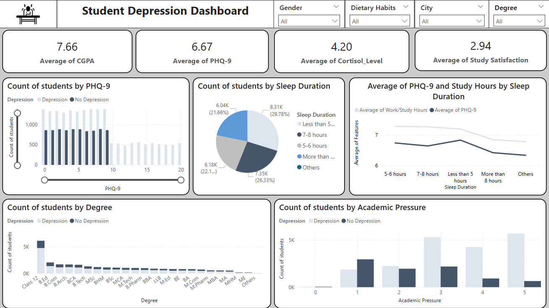
DASHBOARD
Using Power Bi

Slide 17
MODELS

Slide 18
MODELS we used
Types of models evaluated:
1)CatBoost classifier
2)XGBoost classifier
3)Artificial Neural Networks (ANN)
4)Logistic Regression
5)LightGBM Classifier
6)Random Forest
7) KNN
8)Naive Bayes
9)Decision Tree
10)SVM
11)Gradient Boosting

Slide 19

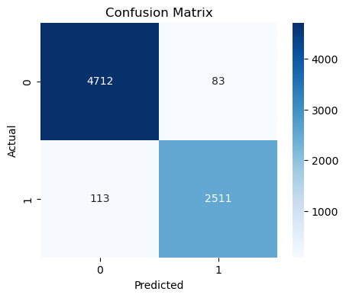
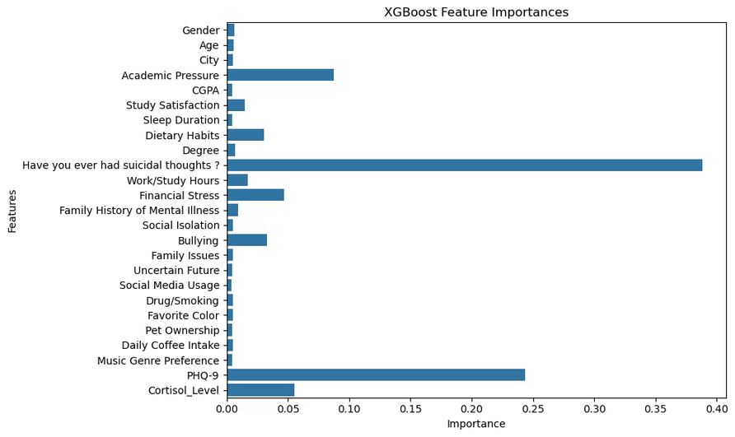
XGB

Slide 20

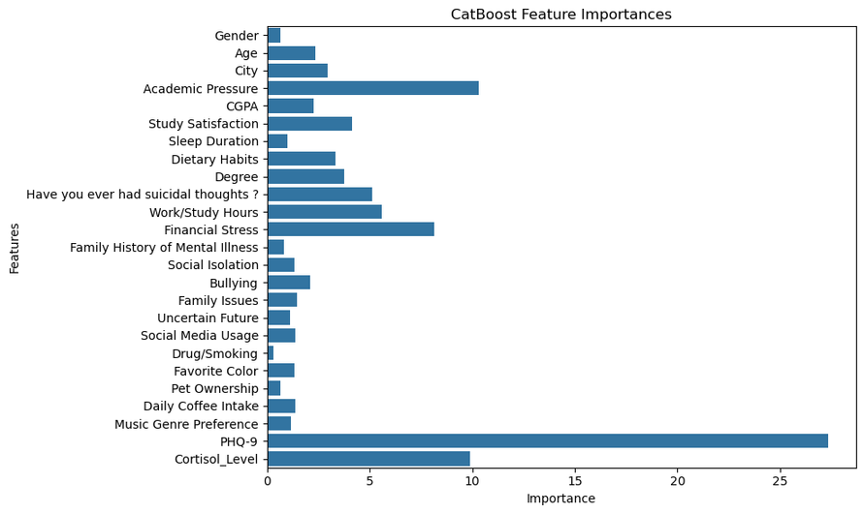
CATBOOST

Slide 21
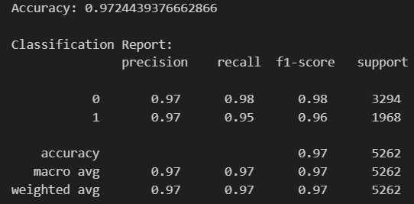
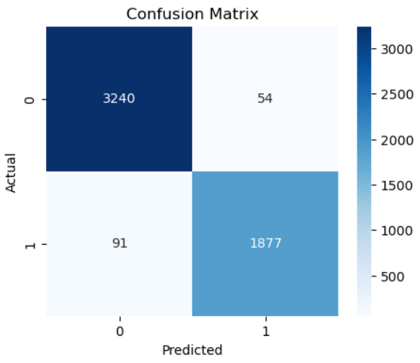
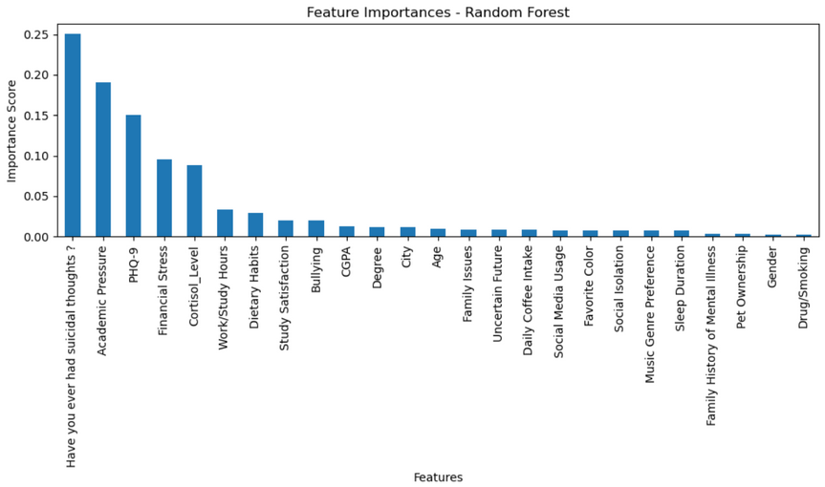
RANDOMFOREST

Slide 22
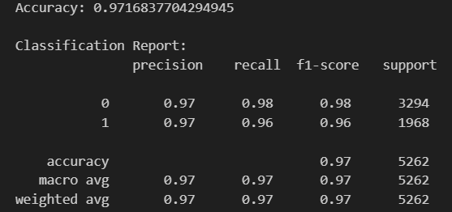
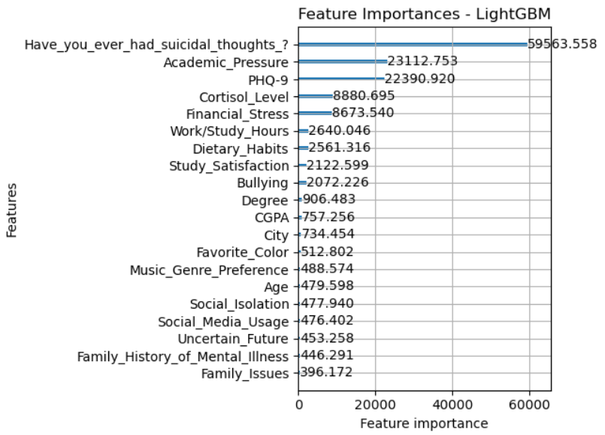

LIGHTGBM

Slide 23
ML FLOW

Slide 24
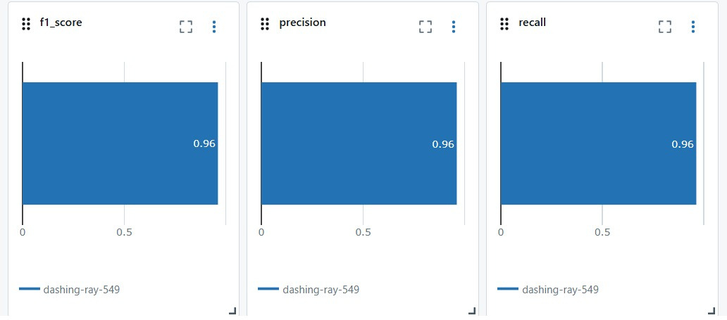
XGB with Smote and Hyperparameter

Slide 25
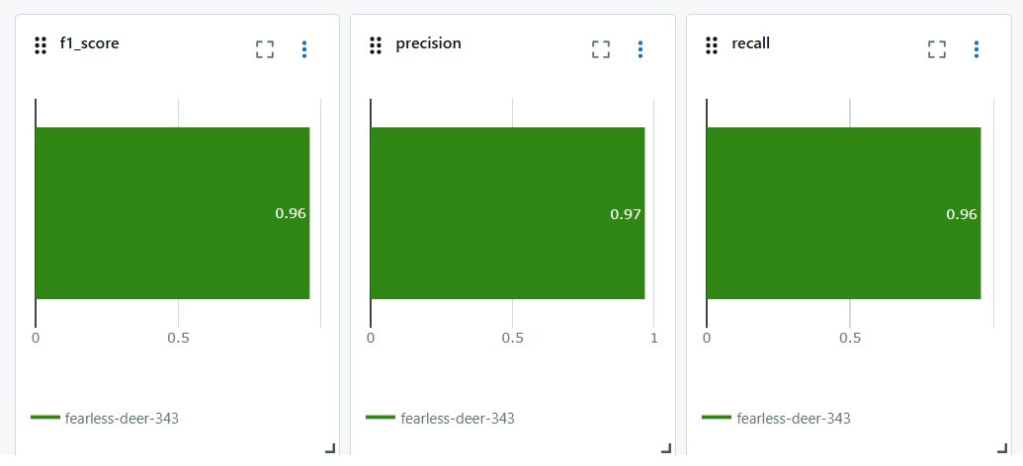
LightGBM with Smote and Hyperparameter

Slide 26
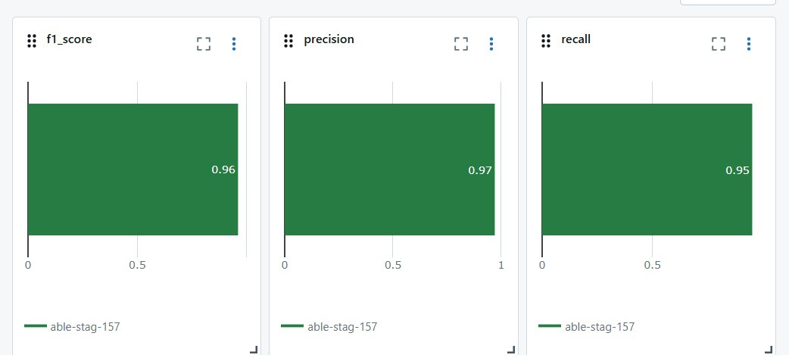
Catboost with Smote and Hyperparameter

Slide 27
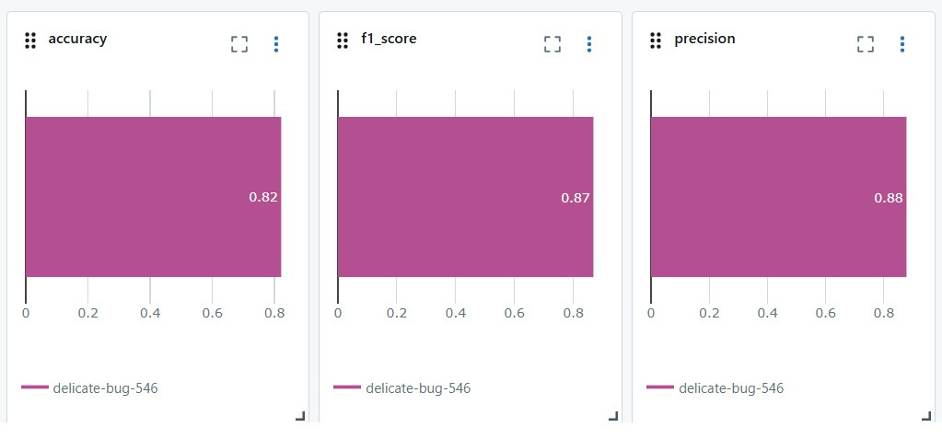
Logistic with Smote

Slide 28

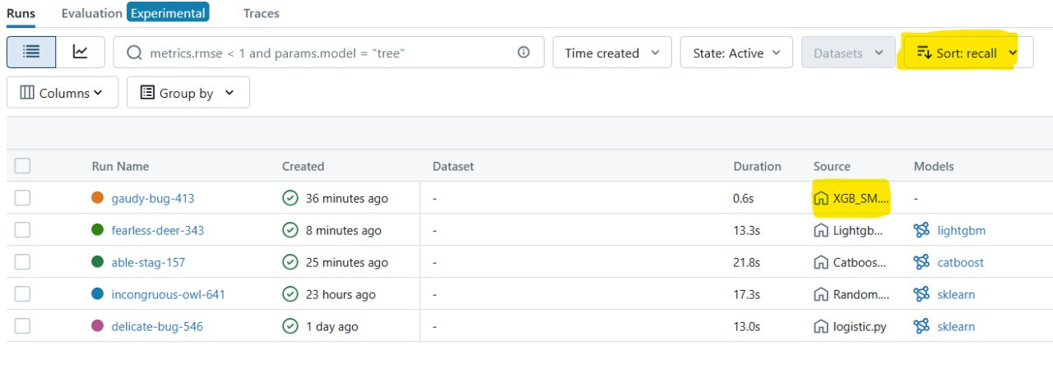
XGB is best model by recall.

Slide 29
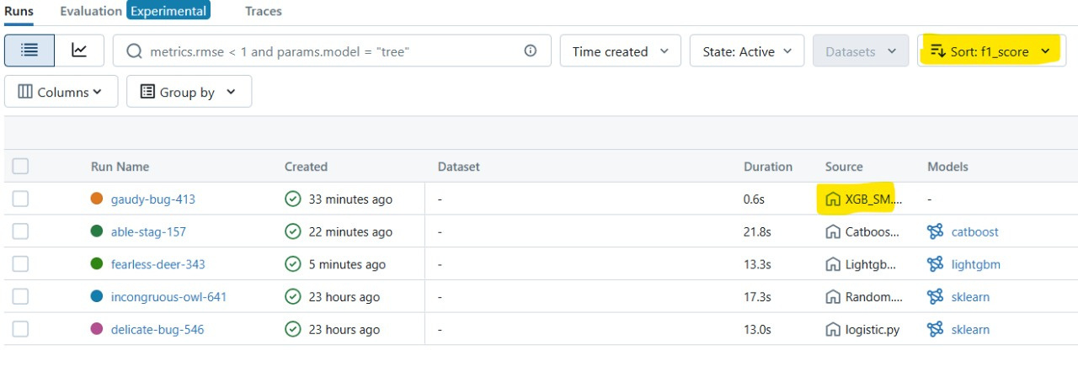
XGB is best model by F1_Score.

Slide 30
DEPLOYMENT

Slide 31
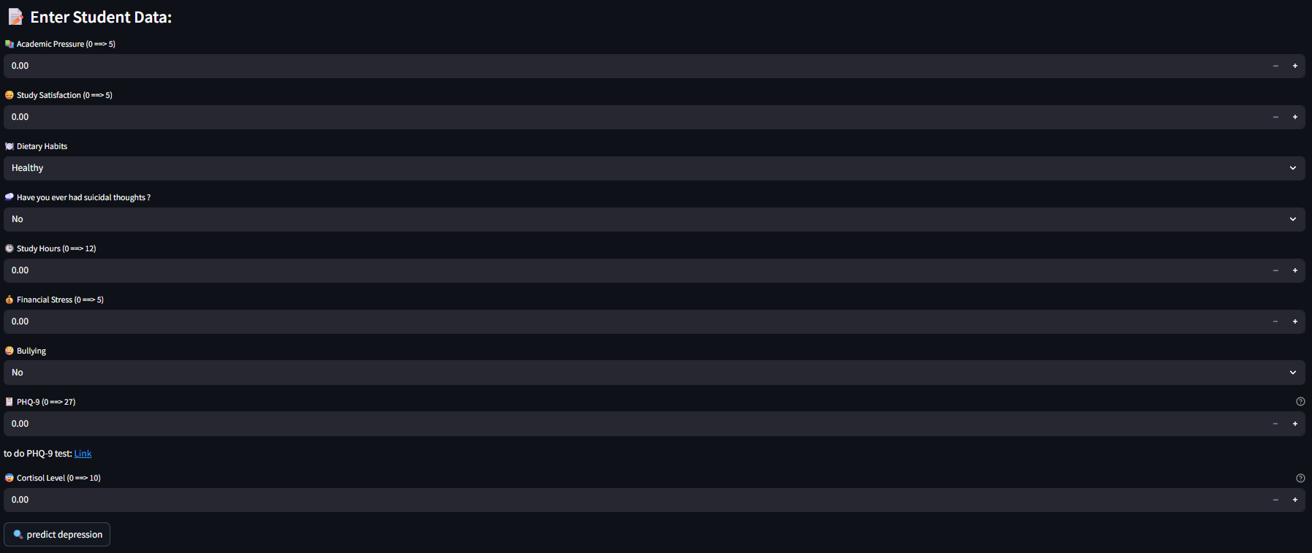
Home Page Deployment
Click here to show the app

Slide 32
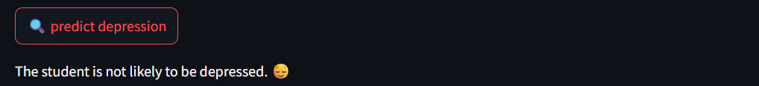

Home Page Deployment
Output:
The application shows prediction to know student is depressed or not.

Slide 33
PROGRAMMING LANGUAGES + FRAMEWORKS :
PROGRAMMING LANGUAGES
Python
FRAMEWORKS/TOOLS:NGUAGES
Kaggle: data collection.
Pandas & NumPy: For data manipulation and analysis.
Matplotlib & Seaborn & plotly: For creating visualizations.
Power BI: For creating interactive dashboards.
Scikit-learn: For implementing machine learning models.
MLFLOW: for Models Tracking
Streamlit: For deploying interactive web applications.
Github: hosting Streamlit page.
Canva : Presentation & Reports.

Slide 34

SUGGESTIONS
HOW TO REDUCE Student Depression?

Slide 35

ENHANCING ACADEMIC AND SOCIAL SUPPORT
Flexible Deadlines: Allow extensions in cases of verified mental health challenges.
Mentorship Programs: Connect students with upperclassmen or faculty for guidance and support.
Activity Engagement: Encourage participation in sports, arts, and clubs to build belonging.
Stress-Free Zones: Designate calm, tech-free zones in libraries and campuses.
Faculty Training: Educate professors to recognize mental health warning signs.
Anti-Isolation Campaigns: Promote inclusive events to integrate lonely or new students.

Slide 36
PREVENTING BURNOUT AND EMOTIONAL OVERLOAD
Balanced Scheduling: Advise students to avoid overloading credit hours.
Sleep Education: Share the impact of sleep hygiene on mental health.
Nutritional Awareness: Offer guidance on diet’s role in mood and focus.
Financial Counseling: Help reduce stress with budgeting tips and financial aid literacy.
Crisis Intervention: Create fast-response units for urgent psychological care.
Digital Detox Periods: Encourage offline activities during exam weeks.

Slide 37
LIST OF REPORTS AND DOCUMENTATION
App Link: click here to go to the app
Notebook Link: click here to go to the Notebook
Report Link : click here to go to the report

Slide 38

CONTACT US :
Islam Mohamed: 10islammohamed01@gmail.com
Arwa Hamdy: arwahamdymo1042004@gmail.com
Mariam Mostafa Abdelaziz: mariamfarag197@gmail.com
Mariam Mostafa Abdelaal: mariamabdelaal287@gmail.com

Slide 39
We are grateful to ENG. Eslam Elreedy for his efforts in helping us understand all the concepts clearly.
We would also like to express our thanks to DEPI for the great opportunity we have had.
Do you have any questions for us?
THANK YOU

